Slide 1
ECE 313: PROBABILITY WITH ENGINEERING APPLICATIONS
Fall 2023
Prof. Eric Chitambar
Lecture 17

Slide 2

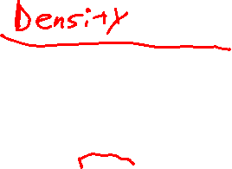
Probability Distribution Function (pdf)

Slide 3




Probability Distribution Function (pdf)

Slide 4



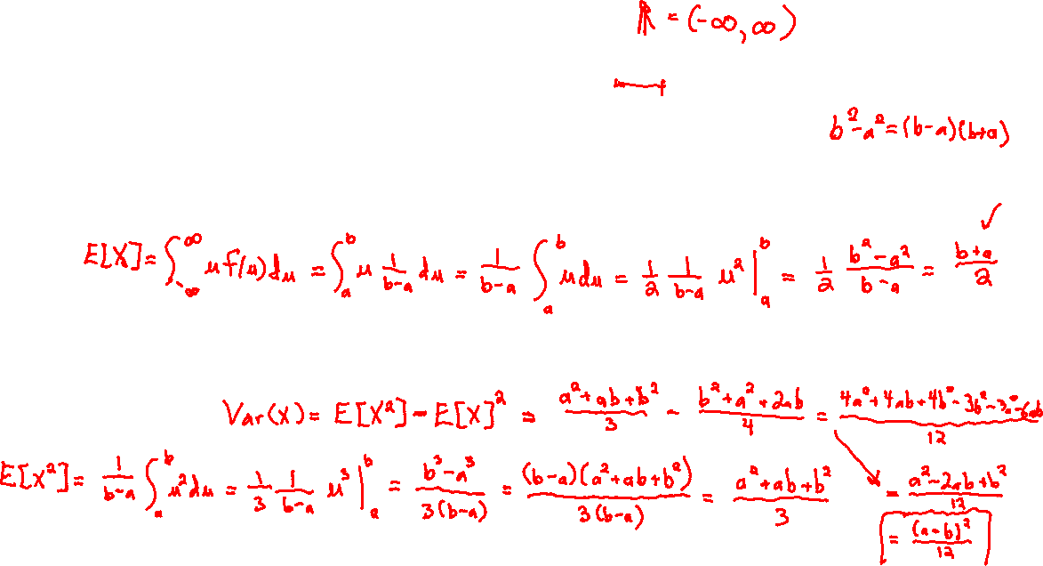
The Uniform Distribution

Slide 5



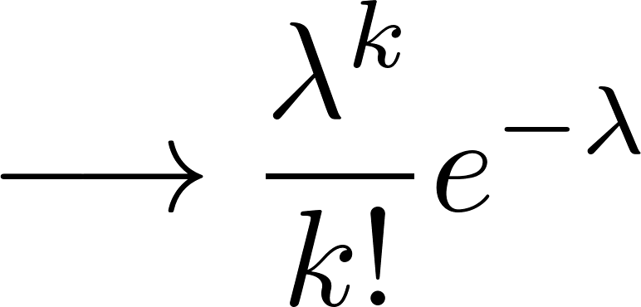
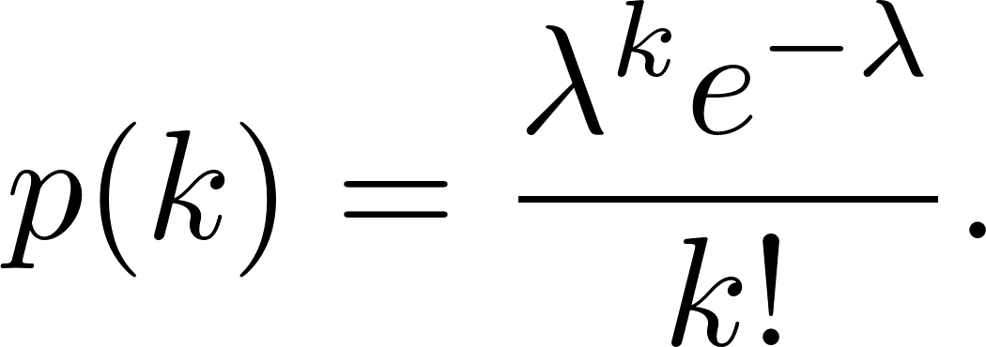

Poisson Distribution

Slide 6



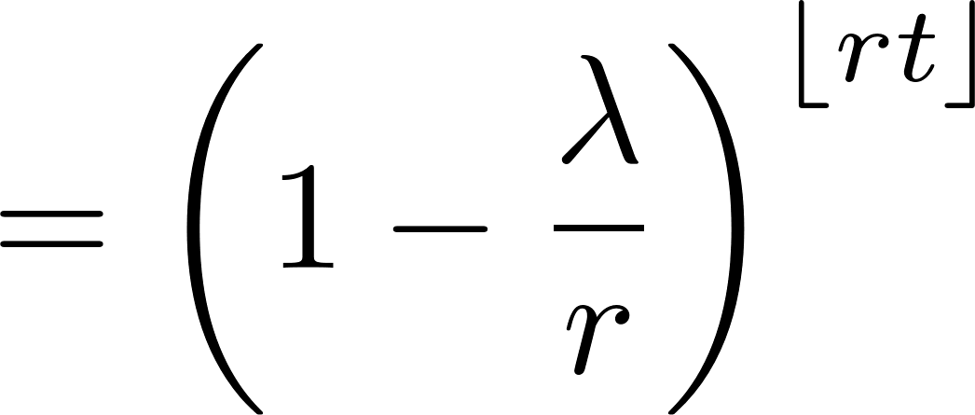




Exponential Distribution

Slide 7





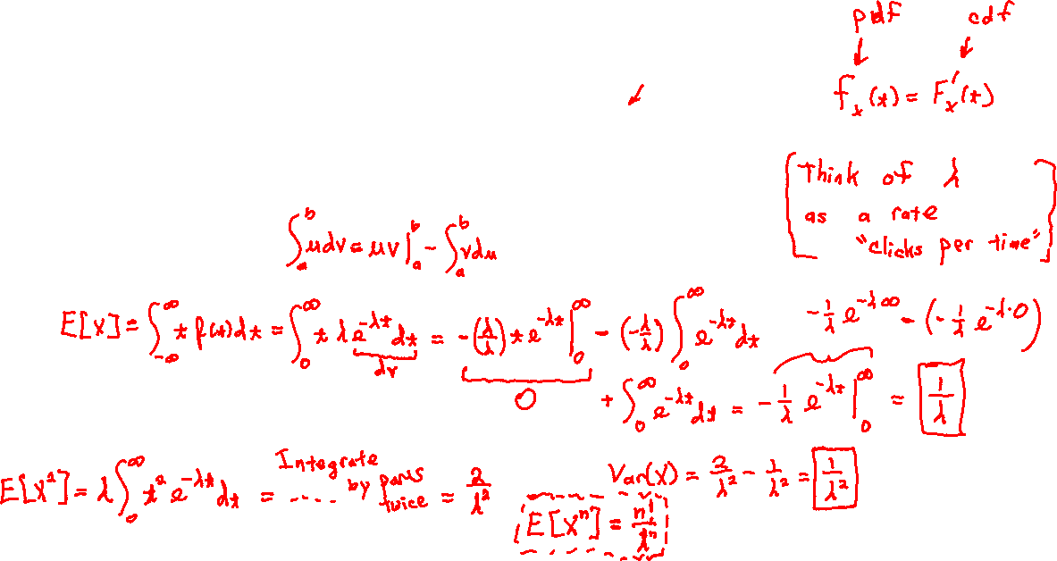
The Exponential Distribution

Slide 8
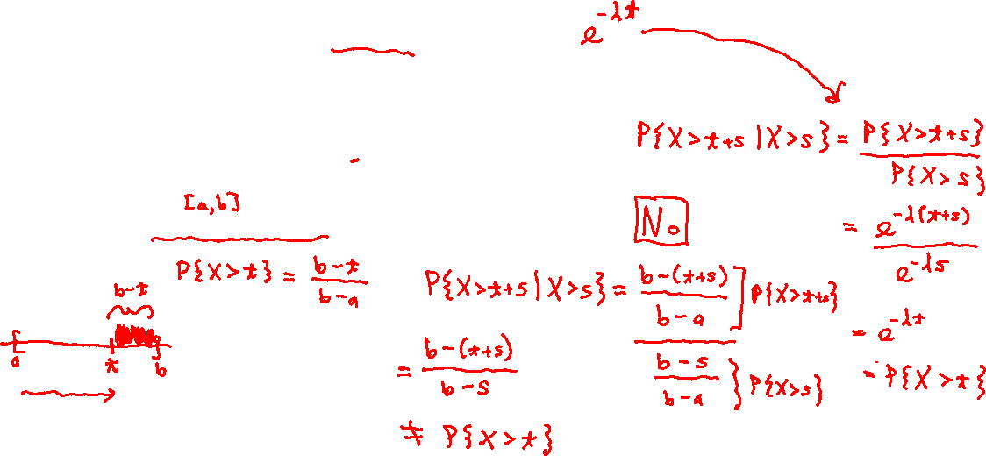
The Exponential Distribution

Slide 9
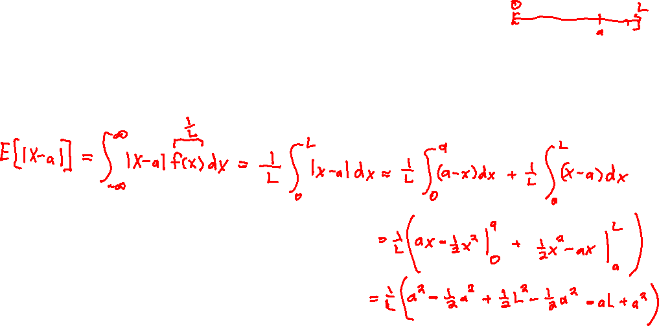
The Uniform and Exponential Distribution

Slide 10
The Uniform and Exponential Distribution

